Slide 1
Analysis of the USDA My Food Pyramid Database
Dylan Cortegana

Slide 2
01
Purpose

Slide 3
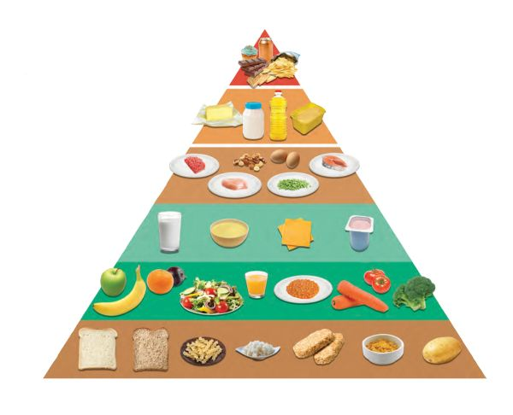
Question
How do macros/calorie sources make up one’s diet?
Are there foods that are more unhealthy than expected?

Slide 4
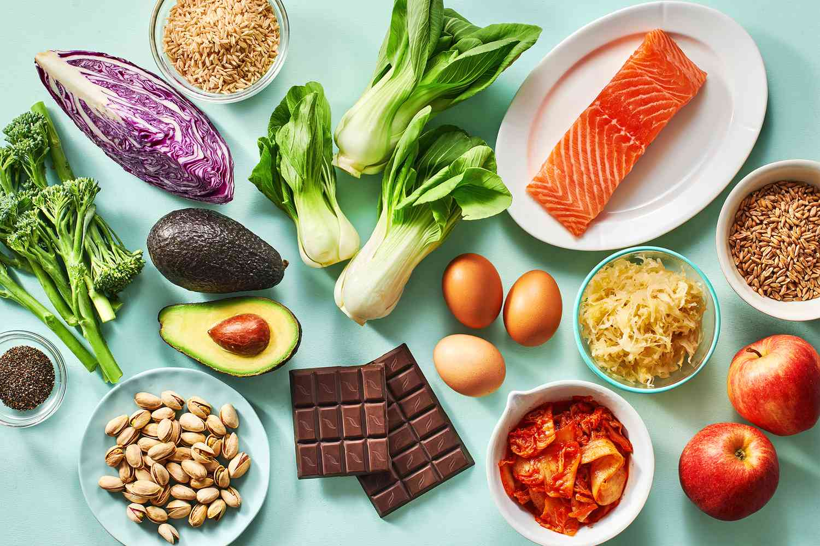
Purpose
Find healthy food alternatives to unhealthy everyday foods
Find foods that can be cut out of diets for better health benefits

Slide 5
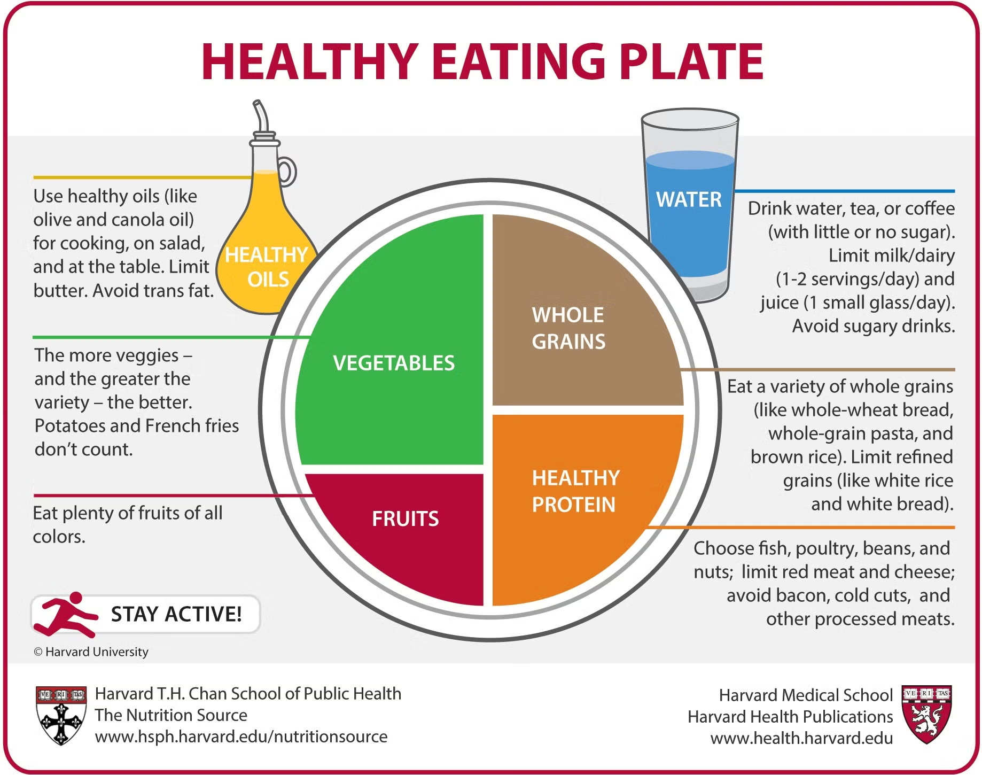
Benefits
Healthier diet
Optimizing diet
Health habits
Dieticians/Personal trainers

Slide 6
02
Methodology

Slide 7
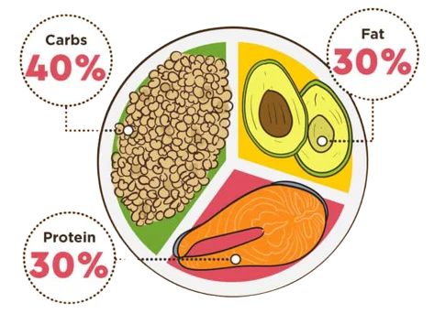
Dataset
USDA My Food Pyramid Database
Information on thousands of food/drink items
Calorie split for each item
Portion sizes
data.gov xlsx

Slide 8
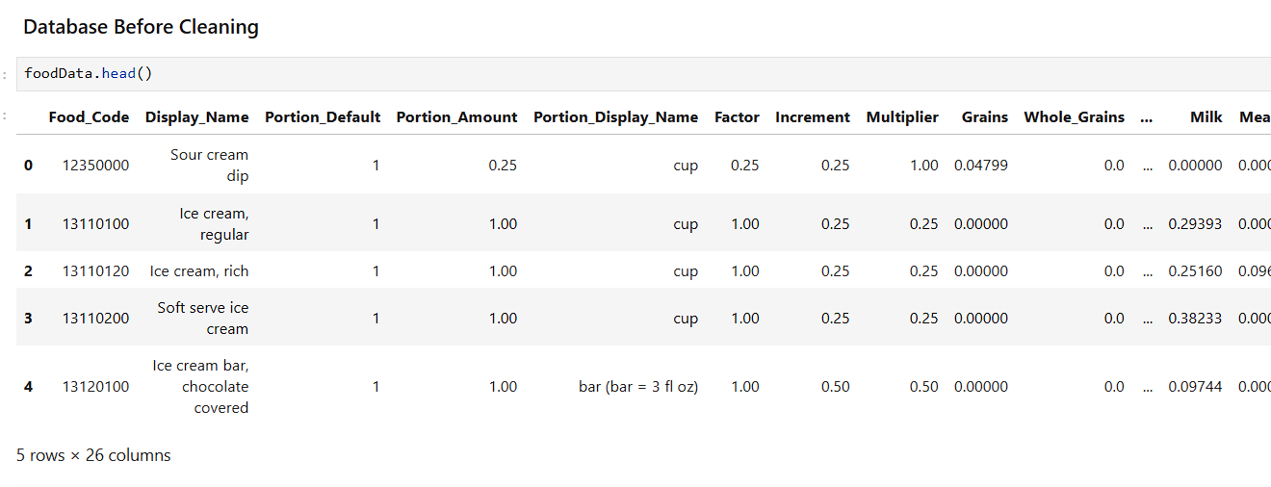
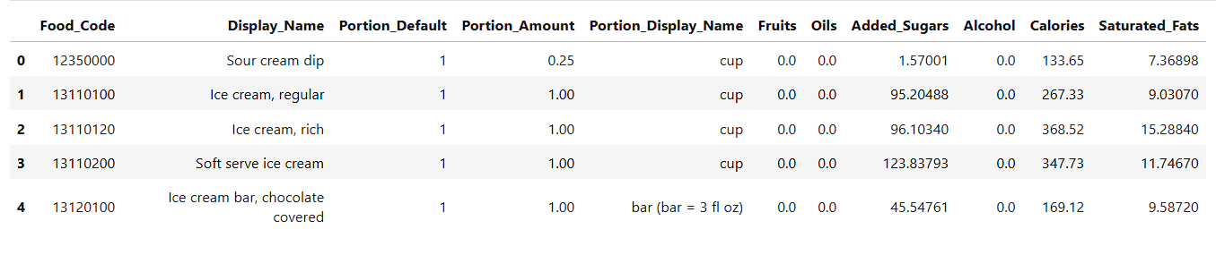
Analysis/Characteristics & Tools
Column cleaning
Pandas/Seaborn

Slide 9
03
Results

Slide 10
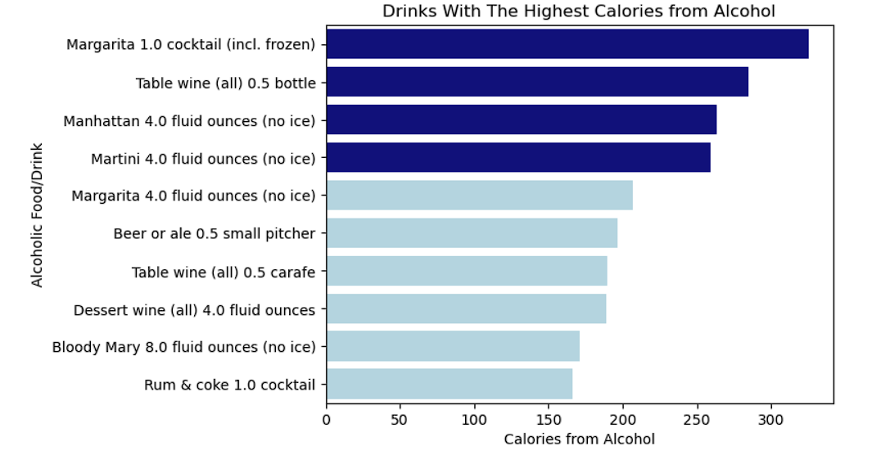
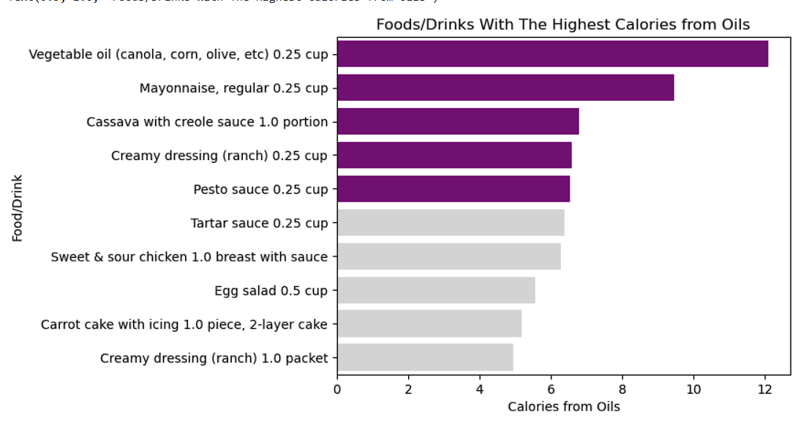
Results
Avoid Margaritas: high in alcoholic calories
Avoid ranch, pesto sauce, and tartar sauce: high in calories from oils
Add more watermelon: most calories from the fruit itself, rather than any added sugars or fats

Slide 11
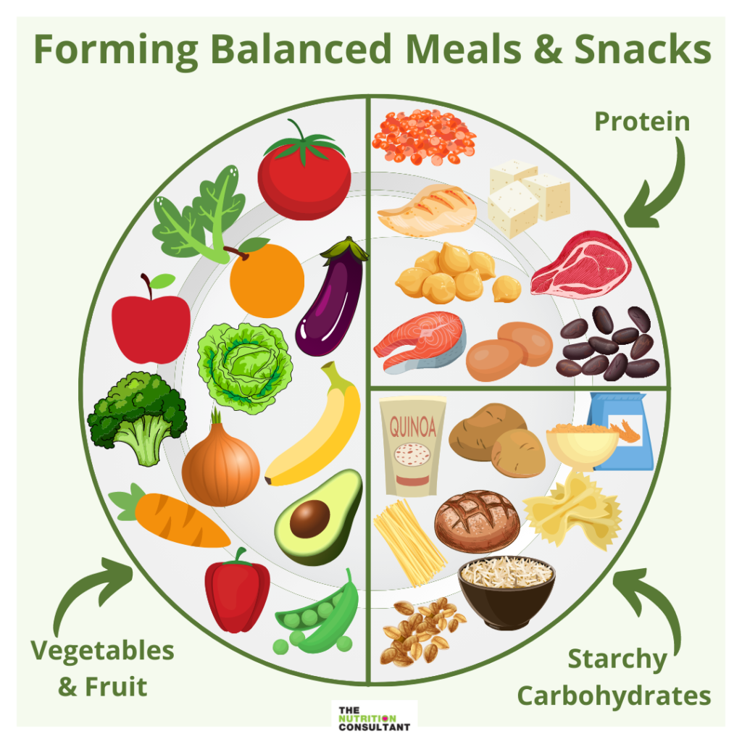
Future Research
Explore the other metrics provided in the database
Portion size
Optimize for diets

Slide 12
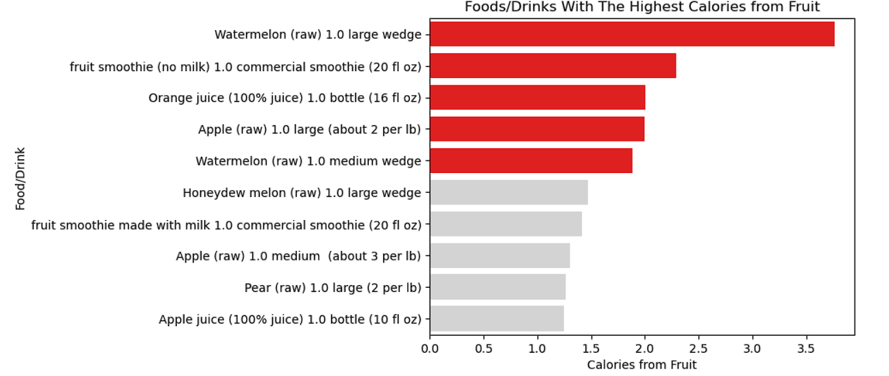
Appendix

Slide 13
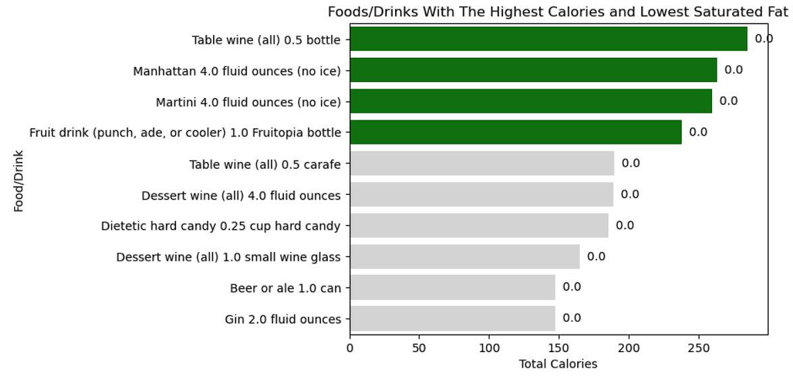
Appendix

Slide 14
THANK YOU

